Slide 1
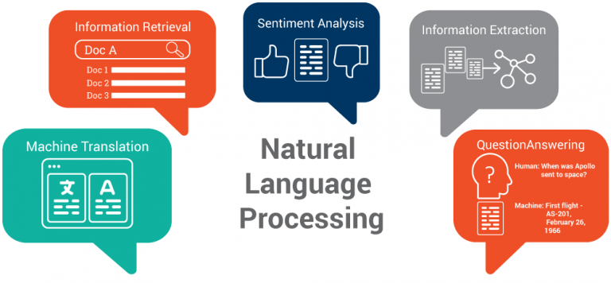

Recent trends in
Natural Language Processing
Balayogi G

Slide 2

Agenda
What is NLP
Motivation for NLP
Methods
Rule based
Statistical based
Types of Neural Networks
RNN Improvements
State of the art
Demonstration

Slide 3

What is NLP
To analyze, understand, generate Human languages with the help of computers.
An Interface between the humans and machines.
E.g. Spell check, chat bots, Grammarly.

Slide 4
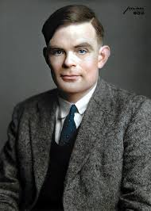
History
1950’s
Alan Turing Second paper “Computing machinery and intelligence”
1954
Georgetown experiment on fully automated Machine translation from
Russian to English.
1966
ELIZA , First computer therapist Bot
1970’s
Conceptual dependency theory for NLP.
1980’s
Statistical Machine translation was developed.
1990’s
NLP Models to increase capabilities.
2006
IBM Watson
2010’s
NLP on homes – Siri, Alexa
Alan Turing
2020*
AI powered Chatbots and more
https://www.csee.umbc.edu/courses/471/papers/turing.pdf
http://www.hutchinsweb.me.uk/GU-IBM-2005.pdf

Slide 5
Methods in NLP
Rule based NLP
Hard code (Grammars, Patterns, Heuristics, etc)
Statistical based NLP
Learning rules from a large set of data(corpus) using statistical techniques like ML and DL.

Slide 6
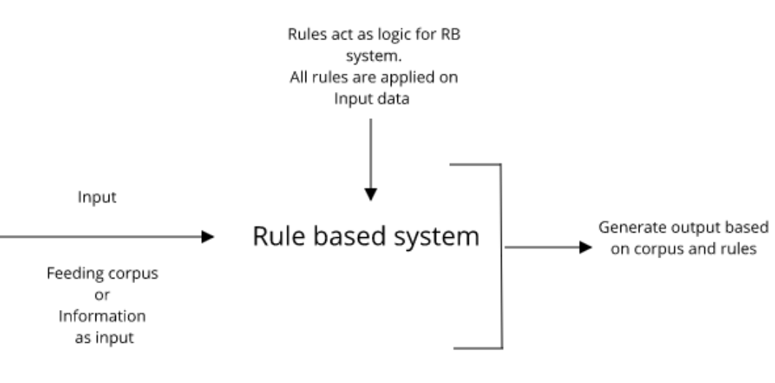
Rule based NLP
Perform well in simple , specific task. But can’t be generalize well.
Some examples,
Preprocessing text
Searching for a specific pattern in a huge dataset.
Analysis of grammar rules.

Slide 7
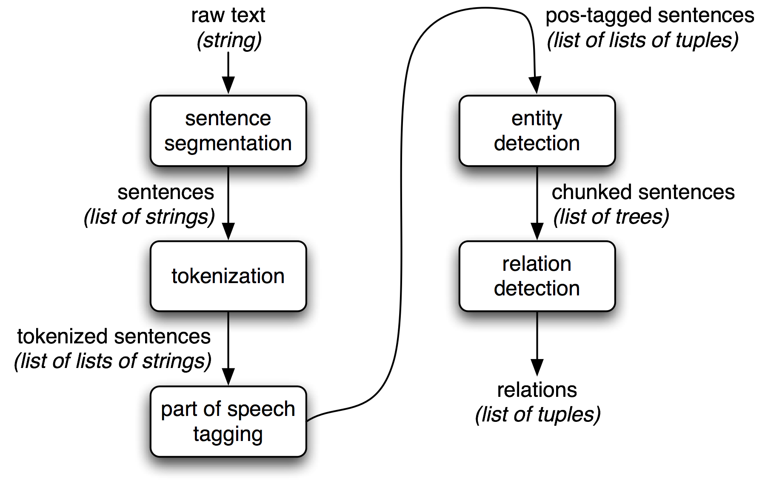
Rule based pipeline for NLP

Slide 8
Lemmatization
Converting words into base form is called lemmatization.
Python packages – Spacy, NLTK.
e.g. Let’s take word, Help
Word | Lemma
Help | Help
Helping | Help
Helped | Help
Helps | Help

Slide 9
Stemming
Converting words into stem word is called stemming.
Python packages – Spacy, NLTK.
e.g. Let's take few words,
Word | Lemma
Consign | Consign
Adjustable | Adjust
Studying | Study
Formality | Formaliti

Slide 10
Morphological Segmentation
Converting word into Morphemes.
Python packages, Spacy, NLTK, Polyglot.
e.g. Let's take few words
Word | Morphemes
Governments | Govern – ment – s
Processing | Process – ing
Processor | Process – or
Invaluable | In – valuable

Slide 11
Word / Sentence Segmentation
Rule based approach: Morphological analysis based on lexical and grammatical knowledge.
Corpus based approach: Learn words from corpus.
Continuous set of word | Word Segmentation
Whatdoesthisreferto | What does this refer to
Paragraph | Sentence Segmentation
He is a programmer. He always think about his work. | He is a programmer. He always think about his work.

Slide 12
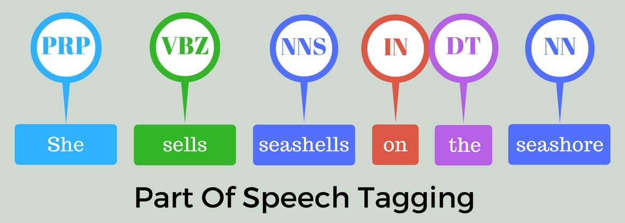
POS-Tagging
Rule based approach: Specific tag given to a token, parts of speech(POS).
For example, verb, noun, pronoun, etc.

Slide 13
Rule based NLP - Demo
Basic NLP processing
https://colab.research.google.com/drive/1MVBJKFAAJyHjCOmuINC7IrHArNnwC8wz
POS tagging
https://colab.research.google.com/drive/1jQ7kp_RUE0Os0b4HLB7kLEQ6S1nzWVKJ

Slide 14
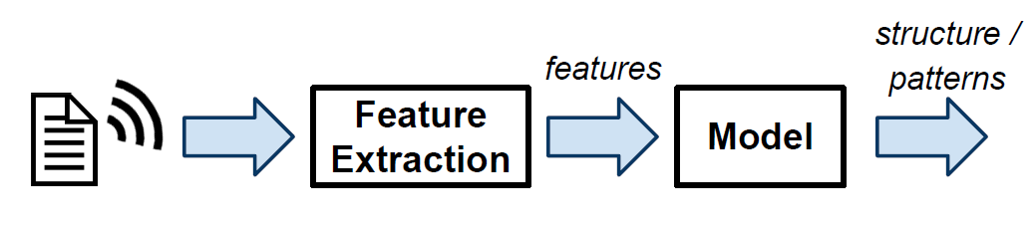
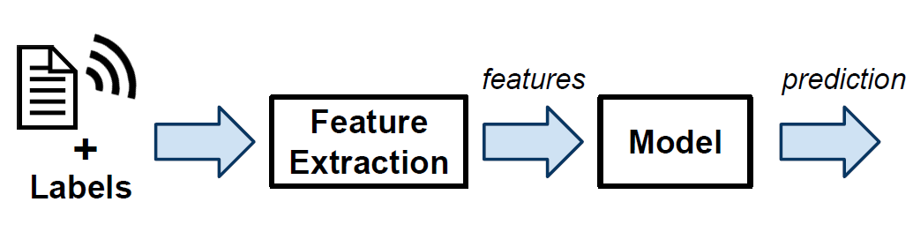
Statistical based Learning
Before Deep Learning
Unsupervised Learning
Learning structure from unlabeled data
(e.g. clustering, topic modelling)
Supervised Learning
Learning to predict from labelled data
(e.g. regression,
classification, generation, etc.)

Slide 15
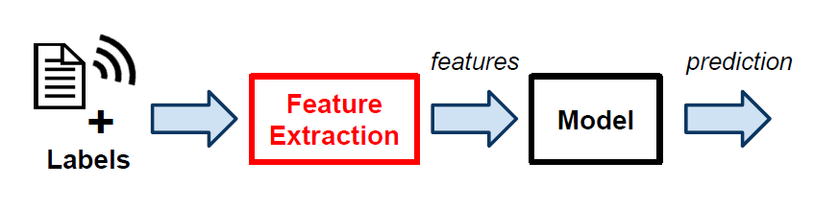
Feature extraction
Manual features
Bag of words features
Tf-idf
N-grams
Word embedding

Slide 16
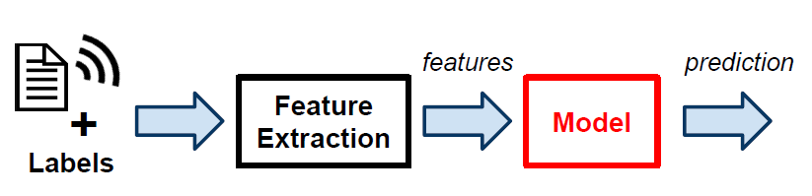
Types of Model
Unsupervised Learning
Clustering(k-means)
Topic modeling(LDA – Latent Dirichlet Allocation ,LSA – Latent semantic Analysis)
Word Embeddings
Supervised Learning
Decision trees
Bayesian algorithms ( Naive Bayes)
Regression algorithms( Linear, Logistic)
Instance based algorithms( KNN, SVM)
Neural Networks
https://machinelearningmastery.com/a-tour-of-machine-learning-algorithms/

Slide 17
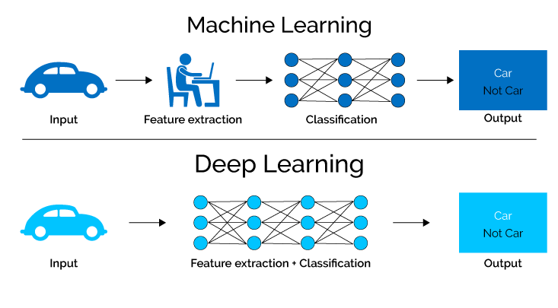
Statistical based Learning
After Deep Learning
Issues with traditional ML techniques:
Hand-engineered features are inefficient.
Representational capacity of model are limited.
Long or/ and variable length sequences are challenging.

Slide 18
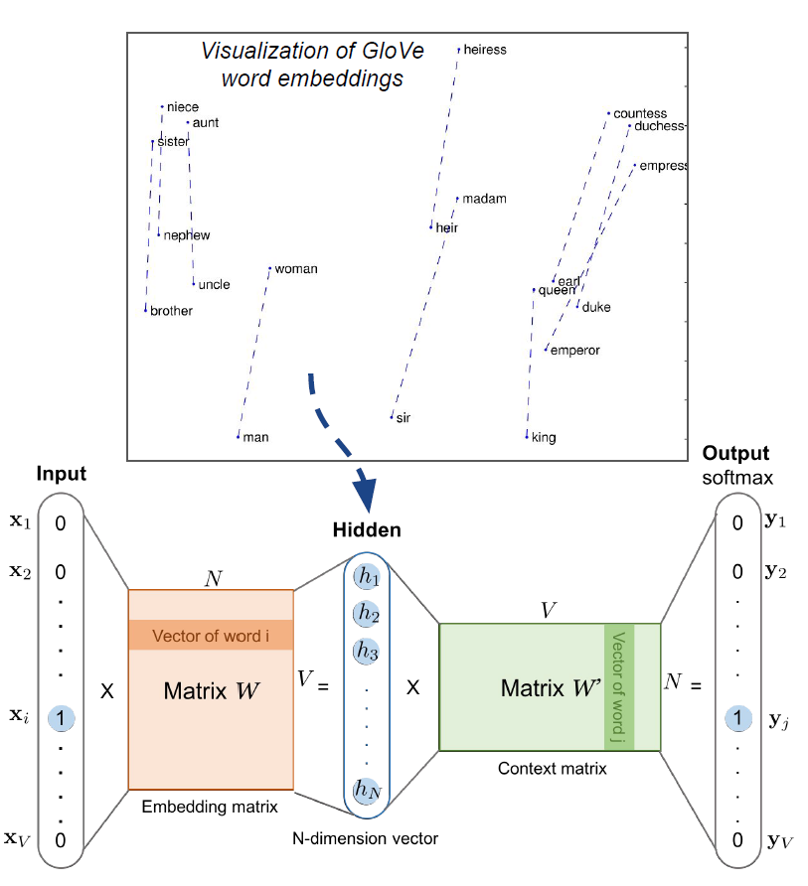
Learning better features
To solve we have word embeddings
Some of the models and algorithms:
Context independent (words):
Word2Vec
GloVe
FastText
Context dependent (sentence):
ELMo – Embedding from Language
Model
InferSent
https://lilianweng.github.io/lil-log/2017/10/15/learning-word-embedding.html

Slide 19
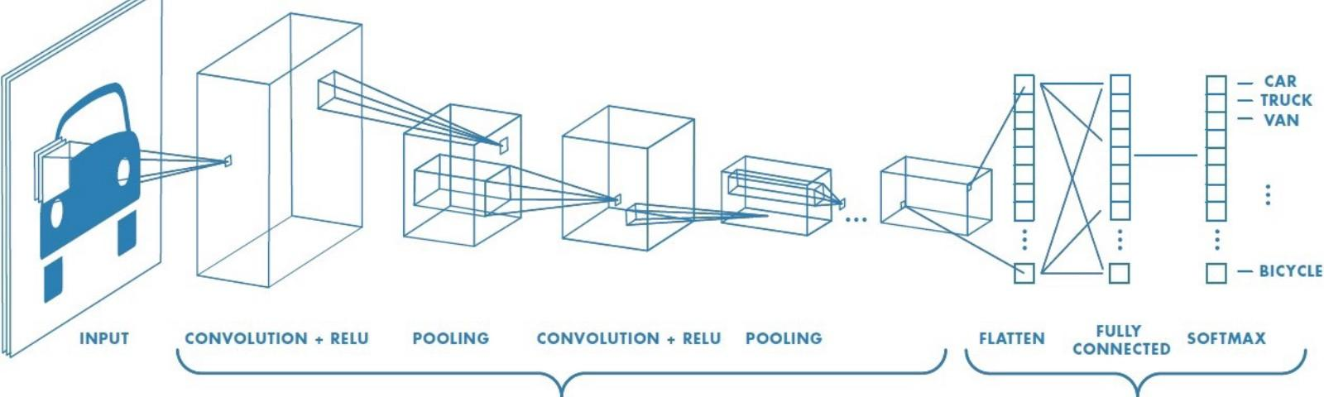
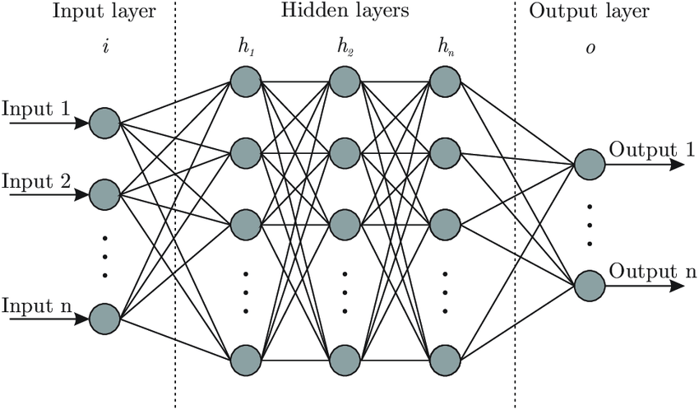
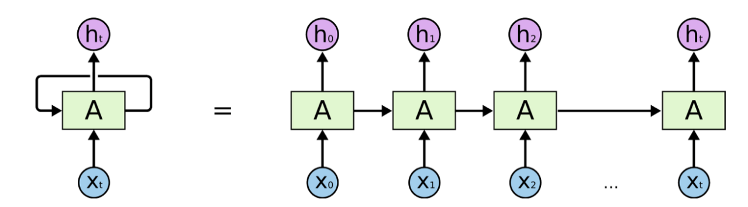
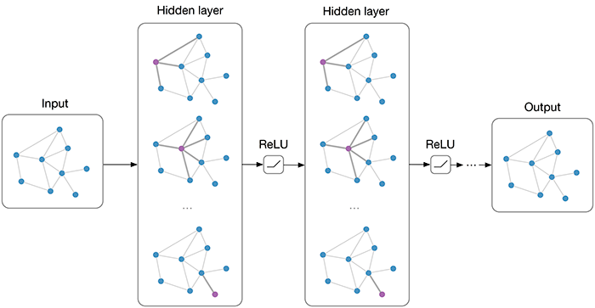
Types of Neural Networks
Fully connected NN
CNN
RNN
GNN

Slide 20
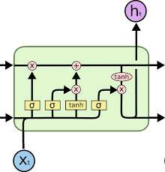
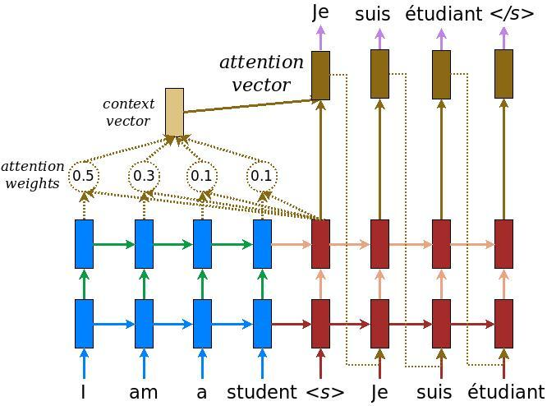
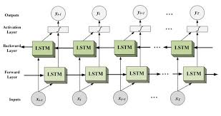
RNN Improvements
LSTM – Long Short Term Memory units
Bidirectional RNN
Attention mechanism
LSTM
unit
Attention mechanism
Bi-directional RNN

Slide 21
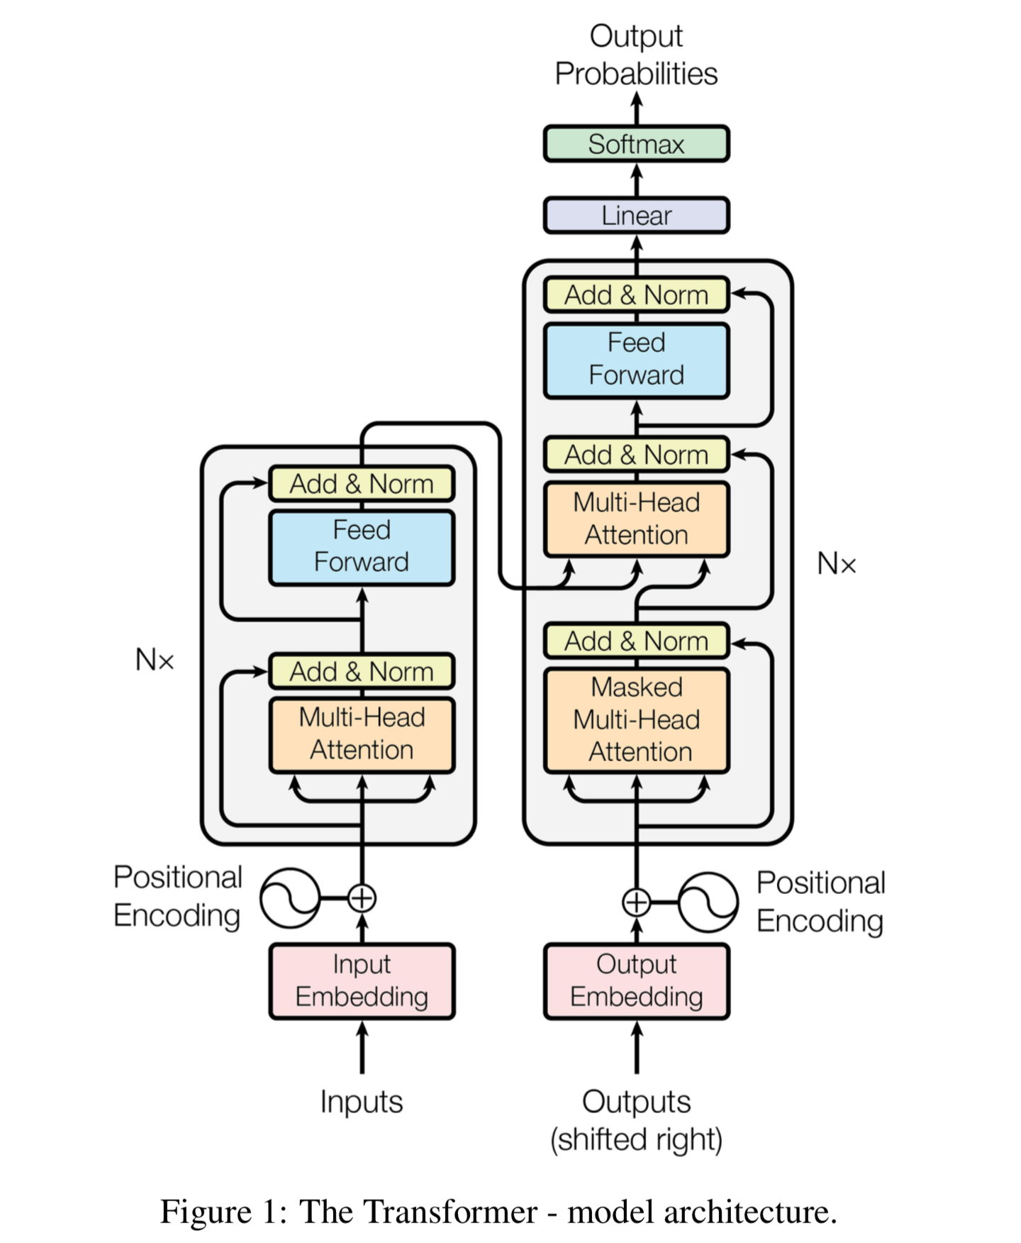
Current State of the Art NLP Model
LSTMs are difficult to parallelize and have challenges for longer sequences.
Transformer networks use only attention mechanisms, with some positional encoding information.
however, they are often huge models with lots of weights.
http://jalammar.github.io/illustrated-transformer/
https://arxiv.org/abs/1706.03762

Slide 22
Statistical based NLP - Demo
https://colab.research.google.com/drive/1LDqNmRgaiPRyUL-
E82Wz31R9tRP35-BV
Manual features
Transformers Networks
https://colab.research.google.com/drive/1RFJaAa0AWVLg8cLj23J5bigKjv-O9mBI#scrollTo=AqwORzIUX_OI
Text classification using
Bag of words model
https://colab.research.google.com/drive/16uf3VAuzUIcbhpSmgINjx7wL8YdvbdNn

Slide 23
Applications
Group 1
Group 2
Group 3
Tokenization
Stemming
Lemmatization
POS tagging
Query Expansion
Parsing
Topic segmentation/recognition
Morphological Segmentation(word / sentence)
Information retrieval/ extraction
Relationship extraction
Named Entity recognition
Sentiment analysis / sentence boundary disambiguation
Word sense / disambiguation
Text similarity
Coreference resolution
Discourse analysis
Machine translation
Automatic summarization and paraphrasing
Natural language generation
Reasoning over knowledge based
Question answer system
Dialog system
Image captioning and other multimodal tasks
https://www.datasciencecentral.com/profiles/blogs/overview-of-artificial-intelligence-and-role-of-natural-language

Slide 24
Deep learning algorithms & NLP
Deep Learning Algorithms | NLP Usage
Neural Network | Parts of speech tagging Tokenization Named entity recognition Intent extraction
Recurrent Neural Network | Machine translation Question answering system Image captioning
Recursive Neural Network | Parsing sentences Sentiment analysis Relation classification
Convolutional Neural Network | Spam detection Relation extraction and classification Categorization of search queries

Slide 25
NLP tools and resources
Links:
NLP tools:
NLTK
Spacy
Pattern
Stanza
Gensim
TextBlob
https://medium.com/@phylypo/a-survey-of-the-state-of-the-art-language-models-up-to-early-2020-aba824302c6
https://github.com/sebastianruder/NLP-progress
Machine learning packages:
Pytorch
Scikit-Learn
Tensorflow
https://paperswithcode.com/area/natural-language-processing
https://github.com/sea-bass/intro-nlp
(Programs taken from this repository)
Machine learning packages for NLP:
Transformers
Allen NLP

Slide 26
Thanks for watching☺

